Slide 1

Aero Support Group LLC.
Company Overview

Slide 2

Our Message
We are committed to serve our clients with the highest qualified and trained experts capable of performing a variety Consulting and Training services in accordance with the latest standards.
We are committed to become a International integrated Consulting Company implementing innovation and integrity to all business endeavors.
“Since the inception of Aero Support Group we have established open and flexible communication with our clients. This practice ensures a positive business experience for our clients and Aero Support Group.
Aero Support Group

Slide 3

Our goal
Our main goal is to contribute to safety, quality and security in aviation industry by working close with Airlines, Airline Alliances, Civil Aviation Authorities, Airport Authorities, Ground/Cargo Handling Companies and keeping aircrafts in air..

Slide 4




Membershıps
In order to maintain and improve our Industry Know-how, oversight our Consultants are monitoring all Industry regulations, standards and best practices.
Our Consultants are member of;
IATA CoPA, IATA Charter of
Professional Auditors
ASQ, American Society for Quality
APQC American Productivity and Quality Center
EFQM European Foundation
for Quality Management

Slide 5











accredıtatıons
Our Consultants are accredited and trained by International Organizations.

Slide 6

Management systems
Aero Support Groups maintains following Management Systems;
Quality Management Risk Management System
Safety Management System
Security Management System
Data Protection System
Information Security Management System

Slide 7
Fıeld of actıvıtıes
Airport Operations Consulting
Quality Control Solutions
Audit Preparation
Training
Safety Management Systems
Quality Management Systems
Security Management Systems
Documentation Support
Operational Support
Drone Operation Systems
IT Software Solutions
Business Process Optimization/ Profit Maximization
Business Planning, Strategy& Execution
Customer and Employee Satisfaction

Slide 8
Fıeld of actıvıtıes
We support your organization during;
Documentation
GAP Analysis
Process integration
Conformance Report
Oversight
Trainings
Review of System
Feedback and continuous improvement
Accident incident reduction
Profitability checks

Slide 9
COMPANY PROFILE

Slide 10
Aero support group Office Locations
ISTANBUL
LONDON

Slide 11
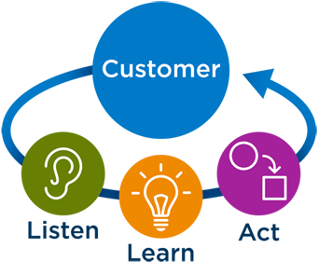
Customer focused approach
The right approach is necessary for the right outcome. Aero Support Group approaches work by applying its external knowledge to your organization’s internal way of doing work. We know that in order to maximize the potential of success for your company we need to shape our expert advice in a way that applies to your way of doing business. This allows us to create rich relationships with our clients.

Slide 12
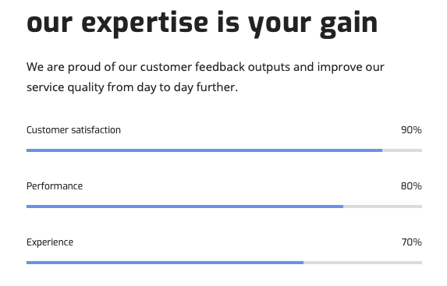
Customer satisfaction

Slide 13
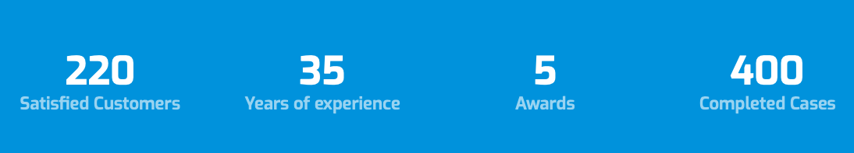
Our performance
We take care of customer satisfaction and thanks to the feedbacks provided we improve our services quality and update our policies, programs and procedures in timely manner.

Slide 14
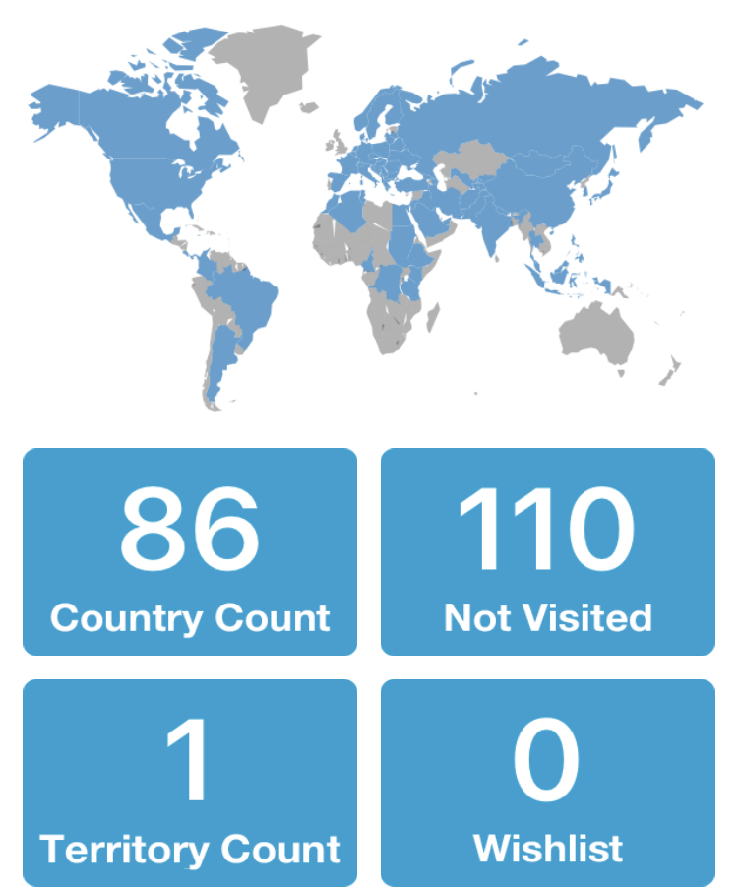
Projects completed
Aero Support Group Consultants have covered 5 Continents and have gathered enormous amount of Know-how.

Slide 15

Projects completed
Aero Support Group Consultants have completed +400 Projects @200 Airports.

Slide 16












Awards/ certıfıcates of appreciations

Slide 17
AERO SUPPORT GROUP
THANK YOU…
info@aerosupport360.com

